Slide 1
Telecommunication churn prediction
SWATHI SRI.R (20MCS1001)
ATHIKA (20MCS1002)
ALTAMASH KAZI (20MCS1012)

Slide 2
introduction
Customer relationship management (CRM) is the combination of practices, strategies and technologies that companies use to manage and analyze customer interactions and data throughout the customer lifecycle.
The goal is to improve customer service relationships and assist in customer retention and drive sales growth.
CRM systems compile customer data across different channels, or points of contact, between the customer and the company, which could include the company's website, telephone, live chat, direct mail, marketing materials and social networks.
CRM systems can also give customer-facing staff members detailed information on customers' personal information, purchase history, buying preferences and concerns.

Slide 3
Literature survey
Prediction of collaborative relationships by using network representation learning: As the importance of supplier-customer relationships has become increasingly apparent that guides modern research and practice, the main impact of such researches is poured into the field of business management and operation research. However, prior studies have indicated that firms tended to manage their relationships in a more structural and relational approach, no existing literature have applied NRL into predicting business relationships [1].
Using an opinion mining approach to exploit Web content in order to improve customer relationship management: A traditional market survey typically seeks out customers' opinions using voluntary questionnaires or focus group interviews. The surveys' perceived and actual reliability could be limited by the number of customers who choose to respond, bias inherent in the wording of the questions or the subjects' interpretation regarding the information being sought. Online opinion resources such as review sites, forums, discussion groups and blogs are available with increasing variety and popularity. Companies can now apply information retrieval, natural language processing and machine learning techniques to automatically and more objectively identify and understand the opinions of their customers [2]

Slide 4
C. A comparison of machine learning techniques for customer churn prediction This work constitutes a comparison of five of the most widely used classification methods on the problem of customers’ churning in the telecommunication sector. In particular, we compare the performance of multi-layer Artificial Neural Networks, Decision Trees, Support Vector Machines, Naïve Bayes classifiers, and Logistic Regression classifiers, compared to their boosting versions in an attempt to further improve their performance [3].
D. Customer Satisfaction and Customer Perceived Value and its Impact on Customer Loyalty: The Mediational role of customer relationship management.In the present-day, many researchers speculate that service related component which have immensely prestigious effect on decision-making measures for the customer; these factors could be quality of the service, customer satisfaction and customer value .Nonetheless, by various researchers relationship between customer satisfaction and loyalty has been highlighted questionably that firms should not entirely rely on customer satisfaction as a key factor and exclusive antecedent for customer loyalty [4]

Slide 5
E. Churn Prediction Model Using Random Forest: Analysis of Machine Learning Techniques for Churn Prediction and Factor Identification in Telecom Sector: Factors of potential churn customer’s usage and behavior which can later be used in customer profiling to specify policies for retention. There exist other methods for rule generation such as Rough Set Theory (RST) [33]. Rough Set Decision based Tree (RDT) performs well, however, in this study we performed customer profiling based on their behavior through k-means clustering algorithm for creating retention policies by decision makers [5].
F. A survey on customer relationship management: For every business success rely upon customers and there arise need to know about pulse of every customers. For that enterprise should know the knowledge about customers’ patterns and behavior. With CRM helps to get in-depth knowledge of customer’s pattern and their behavior which in turn applied in business to make more successful. Analytical techniques are applied in CRM customer data to discover knowledge and patterns. Further how customer’s data privacy is held should be addressed. Further use of big data technologies in CRM can be addressed and use of different data mining techniques can be applied in customer data [6].

Slide 6
G. The Moderation Influence of Power Distance on the Relationship Between Technological Factors and the Successful Implementation of Citizen Relationship Management in the Public Sector: This study found that there is a direct and significant impact of IT infrastructure and system quality on SICzRM. The finding of this study also showed that power distance has a moderation effect on the relationship between IT infrastructure and system quality with SICzRM. But it has no direct effect over SICzRM. This finding confirmed that power distance as a national culture dimension can be added to the TOE theory as a moderator [7].
H. A Survey on Customer Churn Prediction using Machine Learning Techniques: This paper provides a detailed study on the methods used for the process of customer churn prediction. Each of the above churn prediction models has low accuracy and prediction. Hence a good prediction model is required in order to avoid the customer churn problem. Good prediction models have to be constantly developed and a combination of the proposed methods has to be used [8].

Slide 7
I. A Multi-Layer Perceptron Approach for Customer Churn Prediction Data mining technique refers to extracting latent, unknown, meaningful and useful data information from large data sets to investigate the information that can be produced from the extracted data. In Europe, the number of customers who change operators has increased from year to year and the churn rate now stands at 25% up to 2012 on average. The loss of valuable customers will have impact on higher costs to attract new customers, which is five to six times more expensive than customer retention expenses [9].
J. A Development of Web-based Customer Relationship Management (CRM) system for Beauty Clinic A software development methodology (or what is called a process model or software engineering paradigm) is a process strategy that combines the processes, methods, and tools that build software in relation to a broad set of tasks involving requirements analysis, program construction, design, testing, and maintenance. In this development, the authors use the FAST model. By using the FAST method, the author becomes easier in terms of collecting the information needed for the system requirements created in the Almeera SkinCare Beauty Clinic Service Information System [10].

Slide 8
objective
Churn – The term used to describe customer attrition or loss.
Churn rate – The number of participants in churn rate who discontinued their use of services divided by the average number of total participants during a period.
Reasons for churn – Easy to switch provider ,
Quality of services
Inadequate services
Plenty of adequate offers.

Slide 9
modules
Inserting data
Node js
MongoDB
Exploring Schema
MongoDB
Prediction of the data
Pymongo connectivity
Machine learning algorithm

Slide 10
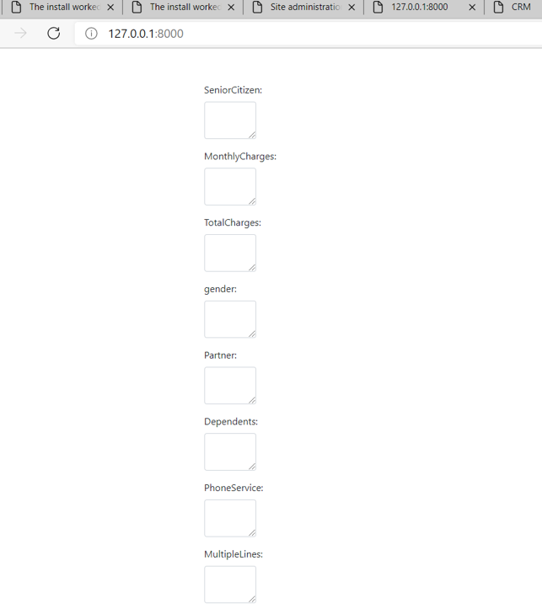
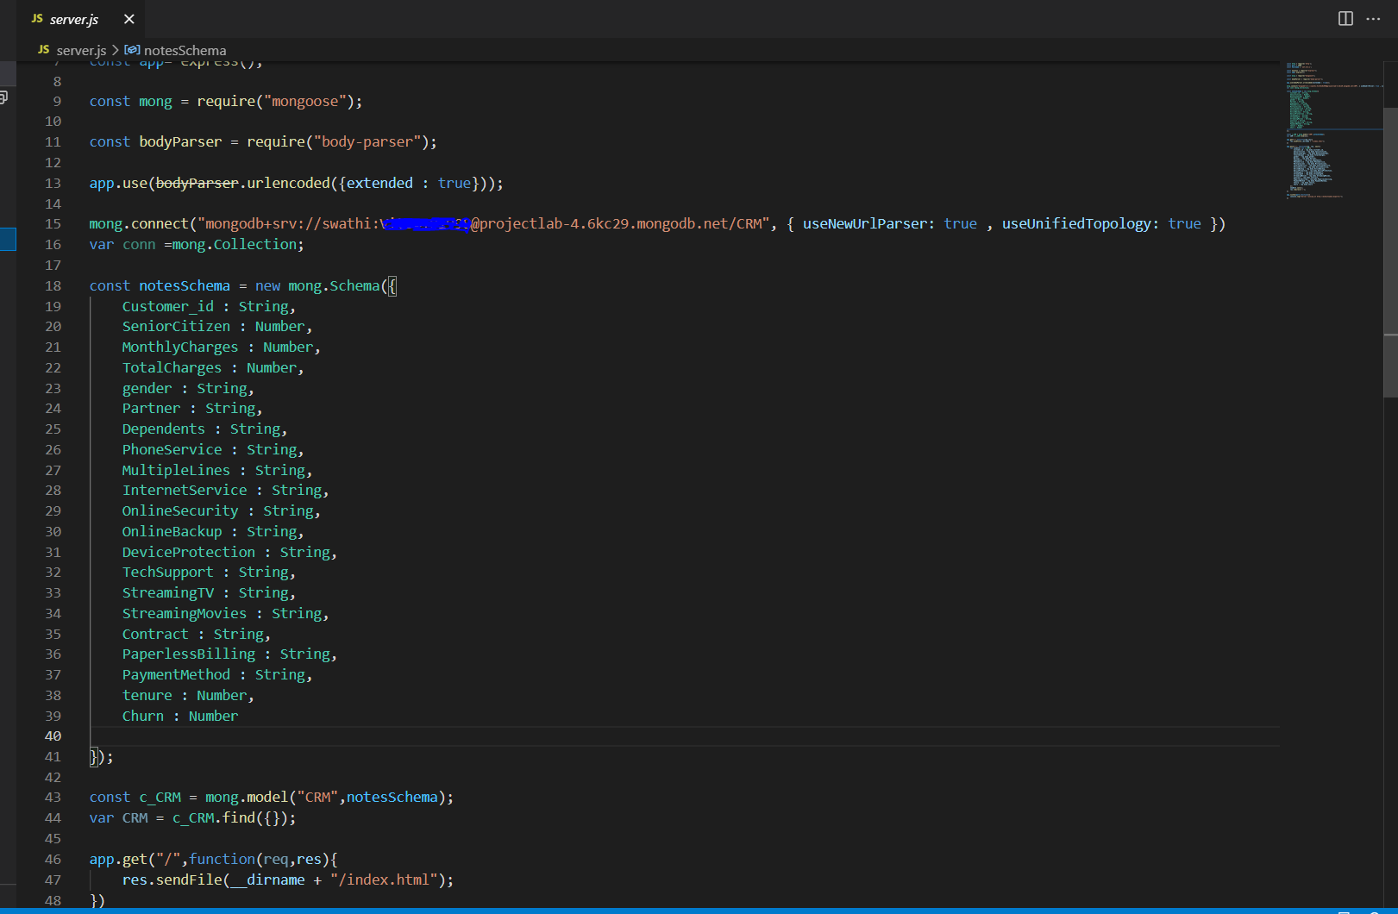
Inserting data

Slide 11
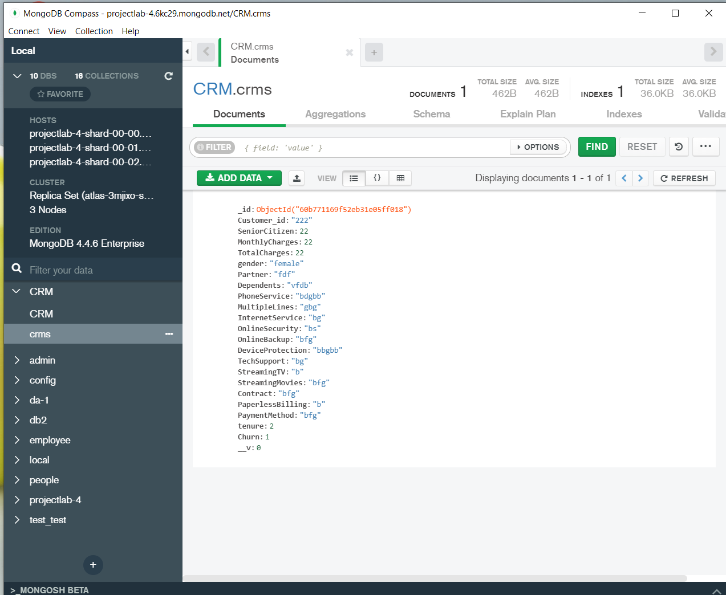

Slide 12
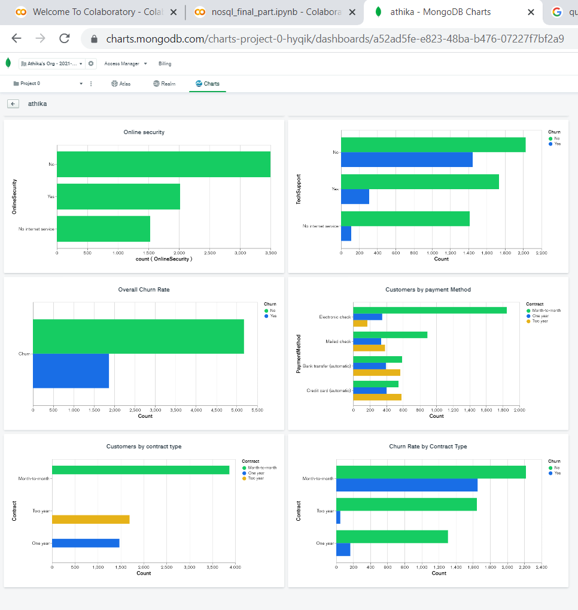
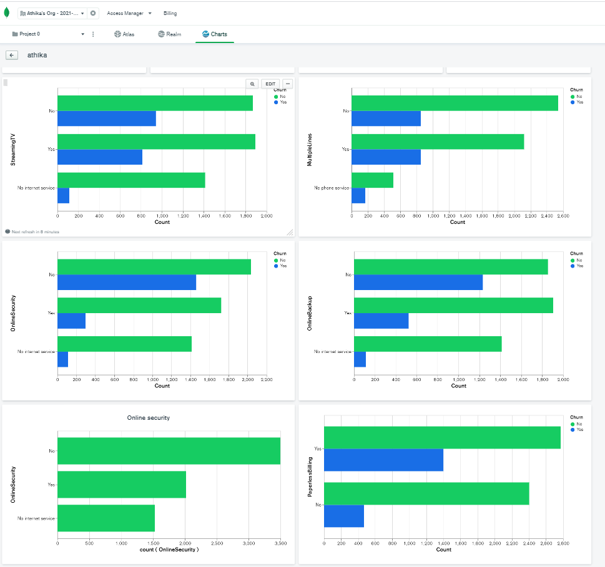
Exploring schema in Mongodb

Slide 13
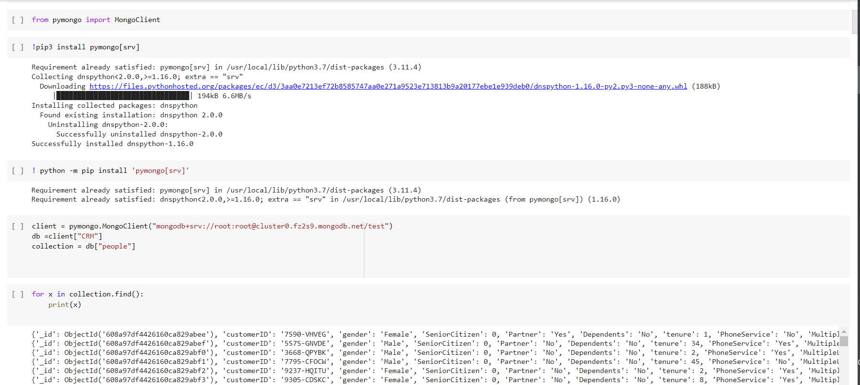
Pymongo connectivity

Slide 14
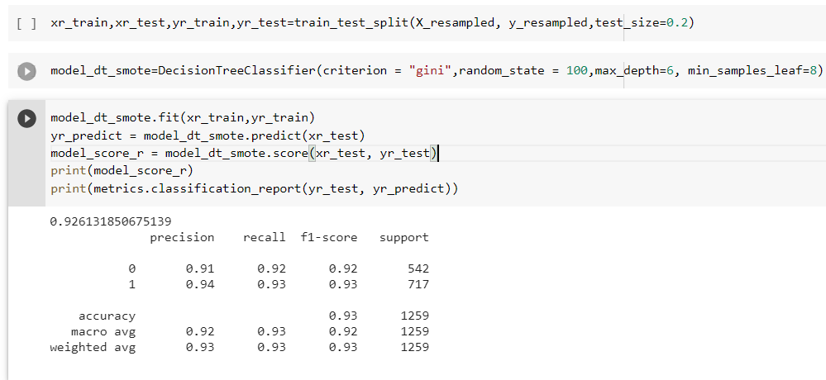
Prediction of the data

Slide 15
CONCLUSION
The importance of the types of research in the telecom market is to help companies to make profit
It has became known that predicting churn is one of the most important source of income to telecom companies
Hence this research aimed to build a system that predicts the churn of customers

